Slide 1
The BigData Top100 List
Initiative
Speakers:
Chaitan Baru, San Diego Supercomputer Center, UC San Diego
Milind Bhandarkar, Greenplum/EMC

Slide 2
Outline
Background
Benchmark Context and Technical Issues
Next Steps in Development of Benchmark
Specifying a Data Analytics Pipeline Workload

Slide 3
What’s new
Article in inaugural issue of Big Data Journal
  Big Data Benchmarking and the Big Data Top100 List by Baru, Bhandarkar, Nambiar, Poess, Rabl, Big Data Journal, Vol.1, No.1, 60-64, Anne Liebert Publications.

Slide 4
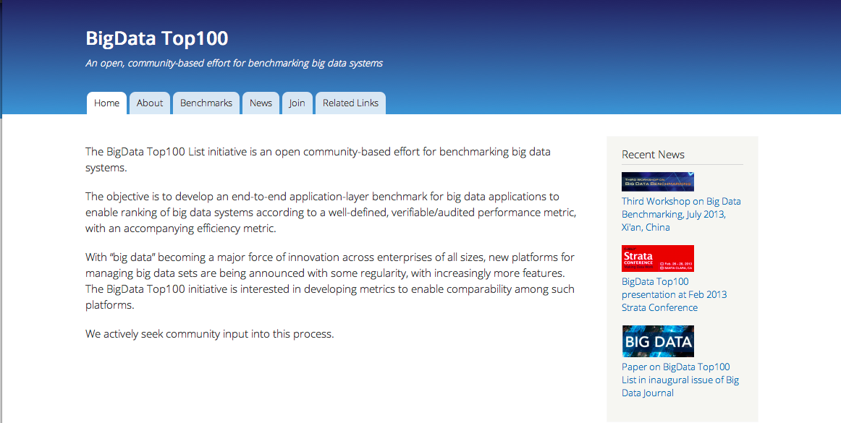
What’s New - 2
BigDataTop100.org Website

Slide 5
Background
Outcome from an NSF research project
  Performance Evaluation of On-demand Provisioning of Data-intensive Applications, 2009-2012.
  Blending use of DBMS and Hadoop
  Evaluation of shared-nothing DBMS vs Hadoop for geospatial data
Identified need for objective benchmarks for big data applications
  Reached out to the TPC world

Slide 6
Context
Launched the Workshop series on Big Data Benchmarking (WBDB)
  First workshop, May 2012, San Jose. Hosted by Brocade.
  Second workshop, December 2012, Pune, India. Hosted by Persistent Systems / Infosys.
  Third workshop, July 2013, Xi’an, China. Hosted by Xi’an University.
First paper:
  Setting the Direction for Big Data Benchmark Standards by C. Baru, M. Bhandarkar, R. Nambiar, M. Poess, and T. Rabl, published in Selected Topics in Performance Evaluation and Benchmarking, Springer-Verlag
Selected WBDB papers in Springer Verlag Lecture Notes in Computer Science

Slide 7
1st and 2nd Workshop Attendees
Actian
AMD
Anna University
BMMsoft
Brocade
CA Labs
Cisco
Cloudera
Convey Computer
CWI/Monet
DBSync LLC
Dell
EPFL
Facebook
Google
Greenplum
Hewlett-Packard
Hortonworks
Indiana Univ / Hathitrust Research Foundation
IIT Chicago
InfoSizing
Informatica
Infosys
Intel
Jacobs University
LinkedIn
MapR/Mahout
Mellanox
Microsoft
NSF
NetApp
NetApp/OpenSFS
Oracle
Persistent
Red Hat
San Diego Supercomputer Center
SAS
Scripps Research Institute
Seagate
Shell
SNIA
SoftCorner
Teradata Corporation
Twitter
UC Irvine
Univ. of Minnesota
University of Passau
Univ. of Toronto
Univ. of Washington
VMware
WhamCloud
Yahoo!

Slide 8
Technical Issues - 1
Audience: Who is the audience for such a benchmark?
  Marketing, Internal Use, Academic Use
Application: What is the application that should be modeled?
  Abstractions of a data pipeline, e.g. Internet-scale business
Single benchmark spec: Is it possible to develop a single benchmark to capture characteristics of multiple applications?
  Single, multi-step benchmark, with plausible end-to-end scenario

Slide 9
Technical Issues - 2
Component vs. end-to-end benchmark. Is it possible to factor out a set of benchmark “components”, which can be isolated and plugged into an end-to-end benchmark(s)?
  The benchmark should consist of individual components that ultimately make up an end-to-end benchmark
Paper and Pencil vs Implementation-based. Should the implementation be specification-driven or implementation-driven?
  Start with an implementation and develop specification at the same time

Slide 10
Technical Issues - 3
Reuse. Can we reuse existing benchmarks?
  Leverage existing work and built-up knowledgebase
Benchmark Data. Where do we get the data from?
  Synthetic data generation: structured, semistructured, unstructured data
Innovation or competition? Should the benchmark be for innovation or competition?
  Successful competitive benchmarks will be used for innovation

Slide 11
Keep in mind principles for good benchmark design
Self-scaling, e.g. TPC-C
Comparability between scale factors
  Results should be comparable at different scales
Technology agnostic (if meaningful to the application)
Simple to run

Slide 12
Other considerations
Extrapolating Results
  To larger configurations
Elasticity and durability
  Big data systems should be intrinsically elastic and durable
  TPC runs ACID outside the performance window
Performance + Price/performance
  Try to capture price in a simple, intuitive, meaningful way…
  For price/performance: what is the most useful quantity for price?

Slide 13
Next Steps
The need to move forward…
Obtain community input: Evaluate two benchmark proposals
  BigBench: based on TPC-DS
    Extended with semistructured and unstructured data and operations on those data
  Data Analytics Pipeline (DAP)
    Proposed end-to-end pipeline, from data ingestion to predictive model testing
See bigdatatop100.org/benchmarks for info
Start a “special” TPC benchmark effort? Or initiate a new org?

Slide 14
Data Analytics Pipeline
Defining A Typical Big Data Workload

Slide 15
Quest for Typical Workload
Tune systems for broadly applicable workloads
Benchmarks most relevant if representative
Designing optimized systems: Make common tasks fast, other tasks possible

Slide 16
Is There a Typical Big Data Workload?
Big Data systems are characterized by flexibility
Multiple Interfaces : SQL, MapReduce, Streaming, GraphLab,…
Workloads evolving rapidly

Slide 17
Encouraging Early Results
Analyzed characteristics of 1M+ real Hadoop jobs on production clusters at Yahoo, 100+ features
Identified 8 Job types
Verified with GridMix 3
Characterization of Hadoop Jobs Using Unsupervised Learning, Sonali Aggarwal, Shashank Phadke & Milind Bhandarkar, in 2010 IEEE Second International Conference on Cloud Computing Technology and Science, Indianapolis, Indiana, December 2010, http://doi.ieeecomputersociety.org/10.1109/CloudCom.2010.20

Slide 18
Big Data Sources
Events
  Direct - Human Initiated
  Indirect - Machine Initiated
Software Sensors (Clickstreams, Locations)
Public Content (blogs, tweets, Status updates, images, videos)

Slide 19
User Modeling
Objective: Determine User-Interests by mining user-activities
Large dimensionality of possible user activities
Typical user has sparse activity vector
Event attributes change over time

Slide 20
User Modeling Pipeline
Data Acquisition
Sessionization
Feature and Target Generation
Model Training
Offline Scoring & Evaluation
Batch Scoring & Upload to serving

Slide 21
Data Acquisition
Batched and collected at the edge
Loaded incrementally
Simple ETL/ELT
Append / Replace

Slide 22
Denormalization / Cleansing
Augment raw events data with attributes
Look up dictionaries
Multi-way Joins with dimension tables

Slide 23
Find Sessions with Target Events
User-Actions of Interest
  Clicks on Ads & Content
  Site & Page visits
  Conversion Events
    Purchases, Quote requests
    Sign-Up for membership etc

Slide 24
Feature Selection
Summary of user activities over a time-window
Aggregates, moving averages, rates over various time-windows
Incrementally updated

Slide 25
Join Targets and Features
Target rates very low: 0.01% ~ 1%
First, construct targets
Filter user activity without targets
Join feature vector with targets

Slide 26
Model Training
Regressions
Boosted Decision Trees
Naive Bayes
Support Vector Machines
Maximum Entropy modeling

Slide 27
Offline Scoring & Evaluations
Apply model weights to features
Pleasantly parallel
Sort by scores and compute metrics
Evaluate metrics

Slide 28
Batch Scoring
Apply models to features from all user activity
Upload scores to serving systems

Slide 29
5 Different Classes
Tiny (10K Entities, 100GB)
Small (100K Entities, 1TB)
Medium (1M Entities, 10 TB)
Large (10M Entities, 100 TB)
Huge (1B Entities, 1PB)

Slide 30
Next Steps: Community input
Contest 1
  By March 31: Submit data and operations for each step in the Big Data Analytics Pipeline.
  By April 2nd week: Review and selection of best data/operations for the pipeline
Contest 2
  By June 15th, 2013: Reference implementation of data/operations in pipeline steps.
  July 2013: Review of reference implementation.
Contest 3.
  By 3rd WBDB, July 2013: Proposals for metrics, execution rules, audit rules and reporting rules.
Review of all inputs, release of benchmark specification: August 31, 2013.

